Slide 1


DON BOSCO INSTITUTE OF TECHNOLOGY
DEPARTMENT OF INFORMATION SCIENCE & ENGINEERING
Academic year 2020-2021
Solution Architecture For Covid-19
BATCH NO | PROJECT MEMBERS | USN
18 | Swaraj | 1DB15IS053
 | Chandra Kiran B | 1DB16IS011
 | Manoj Kumar O | 1DB16IS025
Project Guide - Mrs Gowramma G S
Associate professor and HOD
Information Science and Engineering
Don Bosco Institute of Technology

Slide 2
INTRODUCTION
Corona virus disease (COVID-19) is an infectious disease caused by a newly discovered corona virus.Most people infected with the COVID-19 virus will experience mild to moderate respiratory illness and recover without requiring special treatment
The COVID-19 virus spreads primarily through droplets of saliva or discharge from the nose when an infected person coughs or sneezes.Although for most people COVID-19 causes mild illness,this can be fatal.
Our project mainly focuses on the monitoring of patients health and the precautions taken to avoid the constant transmission using SPO2 level monitor and thermal scanning and providing support to the patients by helping them with the basic needs with the help of food delivery agencies and NGOs. And to help with the prevention

Slide 3
Problem Statement
There is no proper device which helps in constant monitoring for Covid patients
Alcohol gel hand sanitizers are usually applied by squirting the sanitizer liquid when one presses a pump with one’s hand.This causes many people to come into contact with the pump handle, which increases the risk of viral transmission.
No conventional channel for food delivery for the covid-19 patients
There is alternative to get the medicines delivered to the patient's house due to the panic caused by the virus
People being negligent of wearing face masks to prevent the spread of Covid-19
There is no ecosystem which helps helps in catering the basic needs for the patient during their quarantine period

Slide 4
Aims And Objectives Of The Project
The main goal of our project is to design an ecosystem. It provides a complete solution for the patient suffering from covid-19 precaution and checkup.
Monitors patient health by observing SpO2 and Temperature readings and sends these readings to laboratory. Lab report in turn sent to the doctor and doctor verify and send prescription report to patient.
Patient Sends requirement of Medicine to NGO or order from medical Store.
Patient Sends requirement of Food to NGO or order from Online app.
Automatic hand sanitizer machine.
Face Mask Detection and Alerts
Live Corona Status.

Slide 5
Existing System
A long press is made with the footer, such that the mechanical stress is made on the instrument. The mechanical stress made, is forced to spray out the Sanitizer liquid. The human at aged people is unable to use this system as there is mechanical stress and there is a sudden liquid force coming from the sanitizer bottle.
Zomato,swiggy is a delivery-oriented system that allows clients to order food from multiple restaurants at the same time
1MG and MedPlus allows patients to order medicine and other toiletries from the website which is delivered to the doorstep
There are specialized labs which are working on Covid testing
Officials who penalize people for not wearing a mask

Slide 6
Disadvantages of Existing System
Many people to come into contact with the pump handle, which increases the risk of viral transmission.
Zomato and swiggy do not deliver in the contaminated zone
Medicine is not easily available in remote areas
There is a communication gap between the doctor and the testing lab
It is unnecessary wastage of manpower for penalising people for not wearing a mask

Slide 7
Proposed System
Touchless system which dispenses sanitizer
Connecting patient with the food delivery chain
Making easy availability of medicines to the covid patients by door-delivery
Ecosystem which seamlessly connects the patients with all the essential needs which acts as one solution to all the complications faced by the patients
Detects people who are not wearing a mask and alerts them

Slide 8
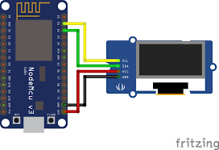
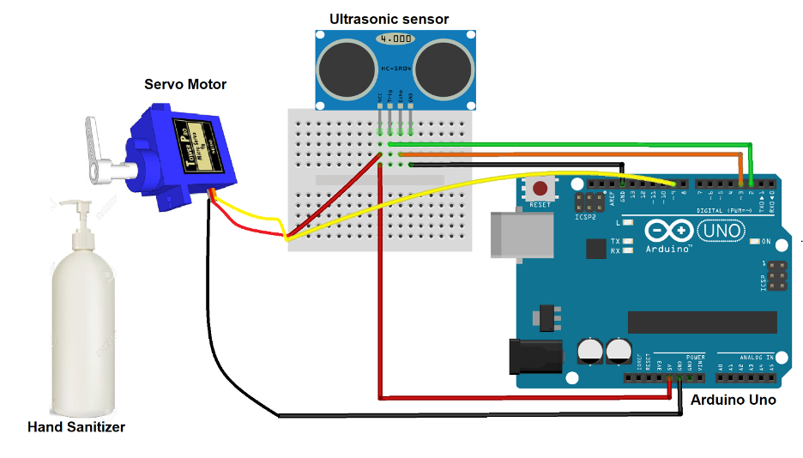
Block Diagram
Live Corona Update
Automatic Hand Sanatizer

Slide 9
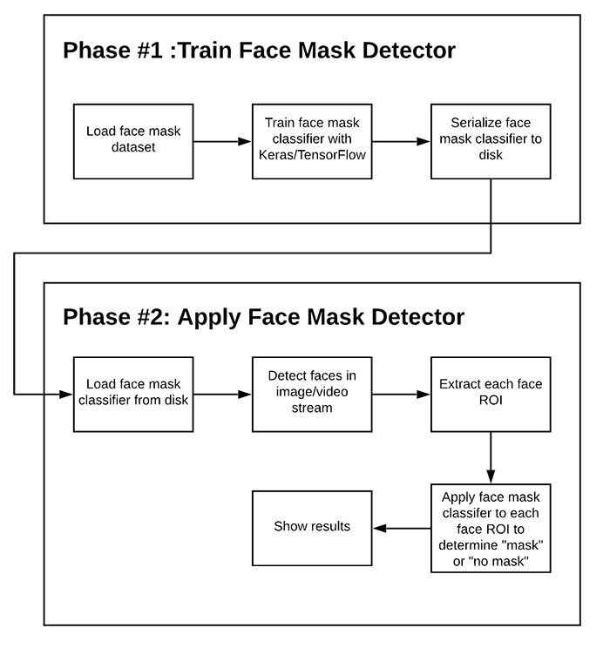
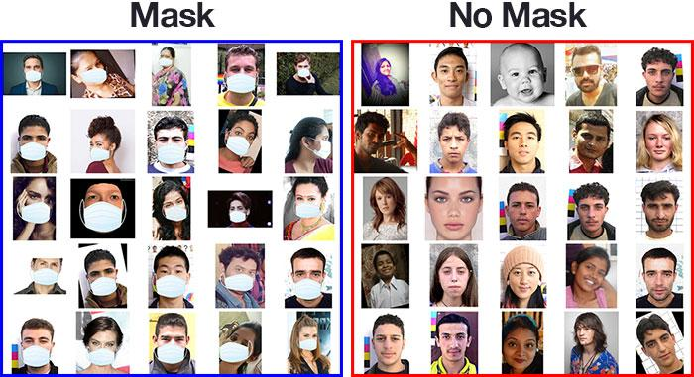
Block Diagram

Slide 10
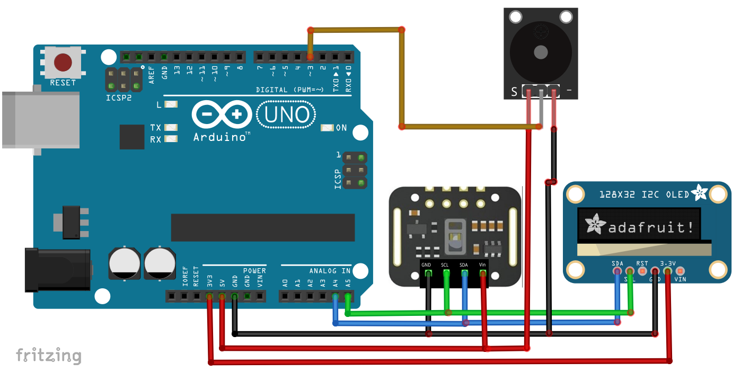
Health Monitoring System

Slide 11
Data Flow Diagram
01
Taking Thermal IR Sensor Value
05
Food Delivery
Raspberry PI Board
04
Connection To NGO
02
Taking SPO2 Value
03
Medicine Recommendation

Slide 12
Advantages of Proposed system
Prevents the contact of the pump handle,which decreases the chances of viral transmission
Seamless connection between the patients and the food delivery chain
Bridges the gap between the patients in quarantine and the medicine delivery
It is a one stop solution to all the challenges faced by the patient who have quarantine themselves and the patients staying in the contaminated zone
Helps people by alerting them to wear a mask and prevents them from paying a penalty

Slide 13
Literature Survey
Paper | Author | Methodology | Advantage | Disadvantage
[1].Self-Activating Sanitizer With Battery Imposed System For Cleansing Hands | M. M. Srihari | The transistors are used to detect and control the motor pump of the sanitizer. | Author used IR sensor for touchless sanitizer | Sometimes it might not work as it takes delay value
[2].Research on infrared body temperature measurement – virus spreading prevention | Andrei Vulpe; Ciprian Lupu; Cosmin Mihai | IR temperature sensors that could help with prevention of virus spreading | infrared temperature measurement solution cheap enough to be used on a large scale | Not displaying on any led display so it is difficult to measure for doctors

Slide 14
Literature Survey
Paper | Author | Methodology | Advantage | Disadvantage
[3].Formal Specification for Online Food Ordering System Using Z Language | P. Saratha; G. V. Uma; B. Santhosh | The static feature includes the state and the relationship output for state transition. The dynamic feature includes the possible operations, relationship between I/O operations and state changes. | focus on creating the accurate order details for customers and ambiguity reduction | Not handy to find covid patients and food delivery for them
[4].A Deep Learning Based Assistive System to Classify COVID-19 Face Mask for Human Safety with YOLOv3 | Md. Rafiuzzaman Bhuiyan; Sharun Akter Khushbu; Md. Sanzidul Islam | dataset put into a model after combining results to fetch the prediction of action level. On behalf of runned the query of single CNN | This unique approach of face mask visualization system attained noticeable output which has 96% classification and detection accuracy. | This approch is little hard and we can solve with less effort

Slide 15
Methodology
There are two ways of automatic hand wash sanitation. One is the without a microcontroller and other is with a microcontroller. The transistors are used to detect and control the motor pump of the sanitizer. The microcontroller is used to control the Sanitizer level, battery level, control solenoid valve and IR detect.
We divided our work into two parts. First part we’ll be discussing about data acquisition and annotation part. In here we briefly cover about our dataset also preprocessing stuff. Next data annotation is used. There are many ways to annotate the data but for our purpose we only care about 3 steps.
Body temperature measurement has always been in the focus of the medical world. There are a lot of certified methods which were developed after years of research and definitely, the highest accuracy is achieved by some sort of physical contact between the measurement device and the patient. However, as recent events have shown, there are cases such as virus pandemics, in which avoidance of direct contact with objects that may be used by other people is strongly recommended. The high contagion rate of viruses such as the recent COVID-19 can be best dealt with by achieving highest degree of prevention possible. This paper does a research on infrared temperature measurement. We also propose a simple solution based on IR temperature sensors that could help with prevention of virus spreading in crowded areas such as office buildings.

Slide 16
Requirements
Functional Requirements
Tracking the live corona counts on an Oled display
Monitors theSpO2and Temperature through a sensor and connect with doctors
Connecting with the NGOs for the services
Connection with the Medical store and to help in getting the medicine
Connects with the restaurants and helps in getting the food delivered
Getting information from labs and giving medical recommendations

Slide 17
Non-Functional Requirements
This project is easy to use and it connects the NGO to the food delivery chain and the medical stores.
All the hardware is easily integrated to get our work done.
We are eliminating human power by automating
It has components that has to be handled carefully

Slide 18





Hardware Requirements
Software Requirements
1.Raspberry pi 7.Servo Motor
2.Arduino 8.Ultrasonic Sensor/IR Sensor
3 .MAx03100 9.Jumper Wire
4 .Thermal sensor
5 .LCD display
6.esp8226
1. Arduino IDE
2.Python IDE
3. Anaconda
4.Things speak
5.Blynk cloud
6.Temboo

Slide 19
Software Description
ARDUINO-The Arduino Integrated Development Environment - or Arduino Software (IDE) - contains a text editor for writing code, a message area, a text console, a toolbar with buttons for common functions and a series of menus. It connects to the Arduino and Genuino hardware to upload programs and communicate with them.
PYTHON-Python is an interpreted, object-oriented, high-level programming language with dynamic semantics. ... Python's simple, easy to learn syntax emphasizes readability and therefore reduces the cost of program maintenance. Python supports modules and packages, which encourages program modularity and code reuse
ANACONDA-Anaconda is a distribution of the Python and R programming languages for scientific computing, that aims to simplify package management and deployment. The distribution includes data-science packages suitable for Windows, Linux, and macOS.
THINGSPEAK :-According to its developers, "ThingSpeak is an open-source Internet of Things application and API to store and retrieve data from things using the HTTP and MQTT protocol over the Internet or via a Local Area Network.
BLYNK :-Blynk is a new platform that allows you to quickly build interfaces for controlling and monitoring your hardware projects from your iOS and Android device. After downloading the Blynk app, you can create a project dashboard and arrange buttons, sliders, graphs, and other widgets onto the screen.
TEMBOO: This is a very interesting platform that provides services to integrate Arduino, Raspberry Pi, and other platforms with differnt internet services (like SMS, Email, and so on). This platform uses choreos that are connectors toward external services, so that events in Arduino, like sensor signals, can be transformed in different kind of events. Moreover, it provides some logic like IF-THEN.

Slide 20
Conclusion
1. Continuous health monitoring by monitoring patient’s health by observing SpO2 and
Temperature readings
2. Provides medicine support to the patients from the NGOs for free or order through apps.
3. Provides food to patient from NGOs for free or order through apps.
4. Providing touchless hand sanitizer machine
5. Face Mask Detection and Alerts
6. Provides time to time update on the status of Covid-19

Slide 21
Bibliography
M. M. Srihari, "Self-Activating Sanitizer With Battery Imposed System For Cleansing Hands," 2020 Second International Conference on Inventive Research in Computing Applications (ICIRCA), Coimbatore, India, 2020, pp. 1102-1105, doi: 10.1109/ICIRCA48905.2020.9183347.
https://ieeexplore.ieee.org/document/9183347
Vulpe, C. Lupu and C. Mihai, "Research on infrared body temperature measurement – virus spreading prevention," 2020 12th International Conference on Electronics, Computers and Artificial Intelligence (ECAI), Bucharest, Romania, 2020, pp. 1-4, doi:10.1109/ECAI50035.2020.9223195.
https://ieeexplore.ieee.org/abstract/document/9223195
P. Saratha, G. V. Uma and B. Santhosh, "Formal Specification for Online Food Ordering System Using Z Language," 2017 Second International Conference on Recent Trends and Challenges in Computational Models (ICRTCCM), Tindivanam, 2017, pp. 343-348
doi: 10.1109/ICRTCCM.2017.59.
https://ieeexplore.ieee.org/document/8057561
M. R. Bhuiyan, S. A. Khushbu and M. S. Islam, "A Deep Learning Based Assistive System to Classify COVID-19 Face Mask for Human Safety with YOLOv3," 2020 11th International Conference on Computing, Communication and Networking Technologies (ICCCNT), Kharagpur, India, 2020, pp. 1-5, doi: 10.1109/ICCCNT49239.2020.9225384.
https://ieeexplore.ieee.org/document/9225384

